Slide 1

SERVE-ON
Presented By :
Atharv Sanajy Gujarathi WRO0713596
Prajyot Anil Thakare WRO0672176
THE INSTITUTE OF CHARTERED ACCOUNTANTS OF INDIA
(NASHIK BRANCH WICASA)

Slide 2
Problem Statement
With the ever-emerging India, home services are growing like a meteor in the industry. Each and every individual surges for the demand for a new thing in the market to cut down the over-exhausted time period and utilize the same on some valuable worksheet.
Lack of resources, unaware about services being provided in market causes person to use their precious time for No Worthy Jobs.
The routine of an urban settler is too tiresome that one loses the motivation to search and acquire home services physically.
Most of the contractors providing traditional home services are strangers to their hosts. Thus, there is a considerable trust deficit.
Lack of co-ordination among service providers to client causing unnecessary time wastage.

Slide 3


Solution
Serve On having access to number of service providers can offer best services across multiple locations.
Serve On is a platform provides home services with Quality, Reliability, timely.
Consumption of services without interruptions in clients operations.
Skilled Professional Service Providers.
One Stop Platform to Various Services
Dependency of Contractors/Agencies for Outsourced continuous services.

Slide 4
Market Opportunity
Target Market
    (a) Niche Market :–
            People with low price sensitivity.
        They will be provided services on Subscription/Premium method.
        They will have access to regular services after every specified
        period on auto-check mode through our professional.
Agency / Contracts :-
These are companies that sells product with after sales services.
Tying up with them to provide after sales services for their
customers or listing them on our platform so that their
customers can easily reach out to them.

Slide 5
Market Opportunity
Size of Market
Market size for this type of services is approx. 6,500 Crore in India.
Market size of all home services considered is approx. 70,000 Crore.
(taken from moneylife.in)
Benefits
Assured Service from Professional with punctuality
Contract providers be tense free of after sales service
Timely Home Checkups to Premium Customers

Slide 6
Revenue Model
Direct Contract Revenue
Depending upon kind of home service requested, amount will be charged accordingly
Platform
Registration Fees
One time fees for registering on platform charged to service provider
Premium
Client able to book services for Specified Period.
Assured additional guarantee from platform.
Free home checkups
Advertisements
Service provider may advertise his services

Slide 7
Competition
Competitor
Platform
Direct : No Such Competitor
Indirect : Urban Company, Housejoy, Local
Service providers
Marketplace
Barriers
Foreign Companies need to do more ground work to understand Indian market
Partnerships {Ground Level Network} with the service providers
Customer & Service Provider
Key differentiators
Involved in large scale projects
Sevices to same customer at multiple locations

Slide 8
Financial Projections
 | Year 1 |  | Year 2 |  | Year on Year Growth
Factors | Q1 + Q2 | Q3 + Q4 | Q1 + Q2 | Q3 + Q4 | (Y2-Y1)/Y1
Revenue | 5,00,000.00 | 6,00,000.00 | 11,00,000.00 | 15,00,000.00 | 136%
Variable Cost | 1,62,500.00 | 1,95,000.00 | 4,20,000.00 | 6,10,000.00 | 188%
Contribution | 3,37,500.00 | 4,05,000.00 | 7,80,000.00 | 8,90,000.00 | 125%
Fixed Costs | 4,80,000.00 | 4,80,000.00 | 6,60,000.00 | 7,20,000.00 | 44%
Profit before taxes | (1,42,500.00) | (75,000.00) | 1,20,000.00 | 1,70,000.00 | 233%
Tax | - | - | - | -
Profit after taxes | (1,42,500.00) | (75,000.00) | 1,20,000.00 | 1,70,000.00 | 2%
VC - Payment Gateway Charges, Free Contract Services, Misc. Expenses.
FC - Employee Benefit Costs, Support Costs, Google Map Charges, Advertisements, Platform Maintainance Charges.
Exemption of Taxes u/s 80 IAC.
Capital Introduction shall be 2.5 lac each by both Founder.
A Tech founder will also bring capital.

Slide 9
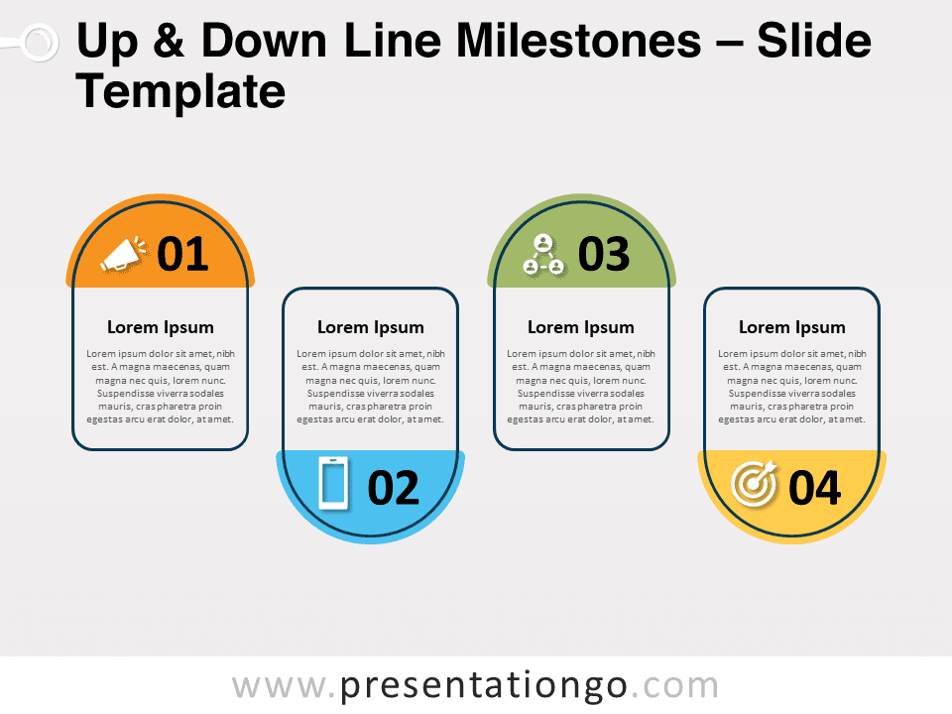
Milestones
Recognition
User Friendly Platform
Long Term Contracts
Rewrite the Industry

Slide 10
Call to Action
Seize the Opportunity to Invest as well as get listed on our platform to have ways to serve.
SERVE-ON
- Home Services Made Easy….

